Slide 1
AUDIT DATA EDA

Slide 2
CONTENT
The goal of the dataset is to help the auditors by building a classification model that can predict the fraudulent firm on the basis the present and historical risk factors. The information about the sectors and the counts of firms are listed respectively as Irrigation (114), Public Health (77), Buildings and Roads (82), Forest (70), Corporate (47), Animal Husbandry (95), Communication (1), Electrical (4), Land (5), Science and Technology (3), Tourism (1), Fisheries (41), Industries (37), Agriculture (200).
This research work is a case study of an external government audit company which is also the external auditor of government firms of India. During audit-planning, auditors examine the business of different government offices but the target to visit the offices with very-high likelihood and significance of misstatements. This is calculated by assessing the risk relevant to the financial reporting goals (Houston, Peters, and Pratt 1999). The three main objective of the study are as follow:
To understand the audit risk analysis work-flow of the company by in-depth interview with the audit employees, and to propose a decision-making framework for risk assessment of firms during audit planning.
To examine the present and historical risk factors for determining the Risk Audit Score for 777 target firms, to implement the Particle Swarm Optimization (PSO) algorithm to rank examined risk factors, and evaluating the Risk Audit Class (Fraud and No-Fraud) of nominated firms.
To examine the present and historical risk factors for determining the Risk Audit Score for 777 target firms, to implement the Particle Swarm Optimization (PSO) algorithm to rank examined risk factors, and evaluating the Risk Audit Class (Fraud and No-Fraud) of nominated firms.

Slide 3
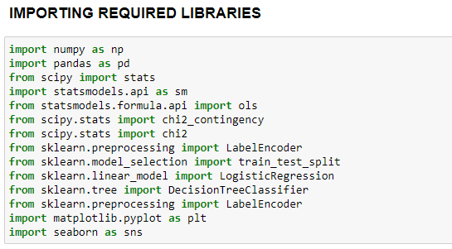
LIBRARIES

Slide 4
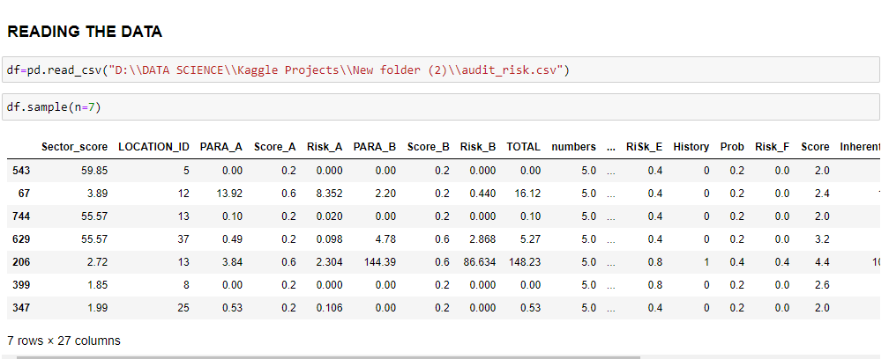
SAMPLE OF DATA

Slide 5
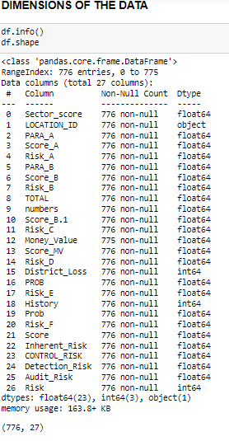
DIMENSIONS OF DATA

Slide 6
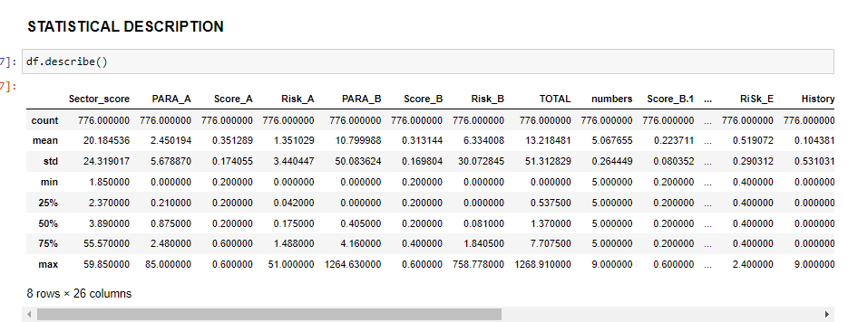
STATISITCAL DESCRIPTION

Slide 7
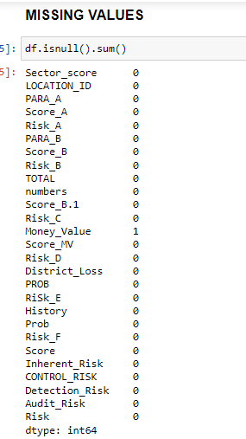
MISSING VALUES
There is only one missing value in the dataset present in Money value column

Slide 8
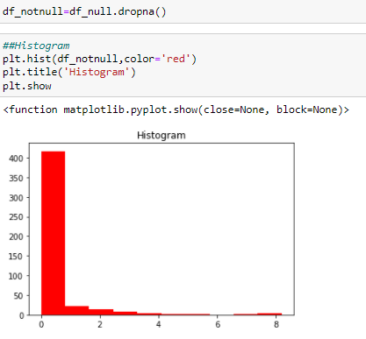

REPLACING NULL VALUES
From the excel sheet we can observe that when target variable has value 0 then the money value column has missing value. So create a data set where the target variable is 0 with money value and check the normality and replace with the corresponding value
Here the distribution is not normal se we will replace with median

Slide 9
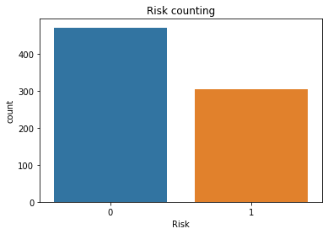
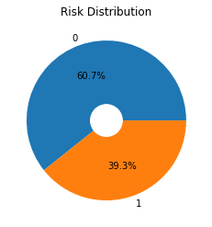
ANALYZING TARGET VARIABLE
There are more counts of not having Risk.Let us see the distibution of the same using pieplot

Slide 10
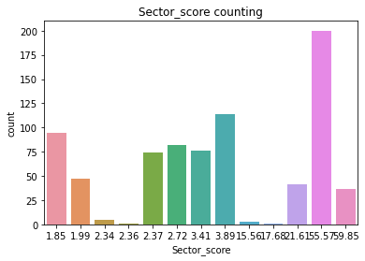
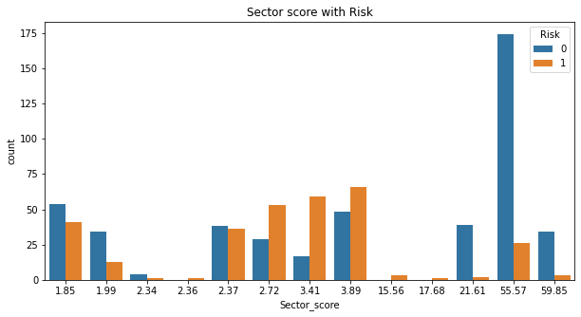
SECTOR SCORE
With sector score 55.57 there is no possibitly of risk, So we can understand that higher the sector score lower the risk. Sector score has different float values with score of 55.57 as highest.Let us analyze the ditribution of each score in the data set using pieplot.

Slide 11
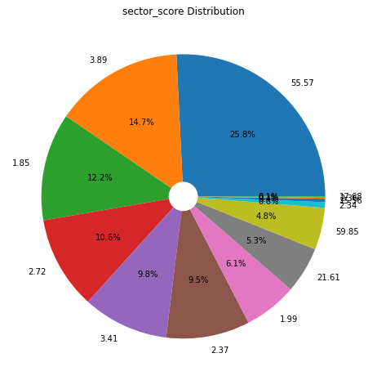
SECTOR SCORE
55.7 score has 25.8% of distribution in the data followed by 3.89 score has 14.7% of distribution

Slide 12
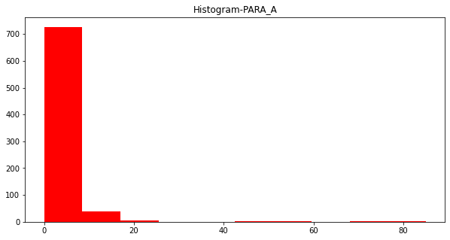
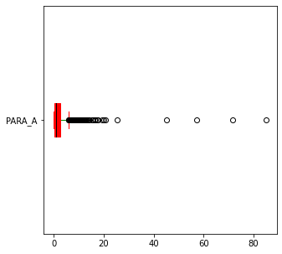
PARA-A
Since there are 10 perecentage of outliers in the data it dosent matter much

Slide 13
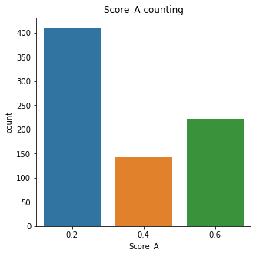
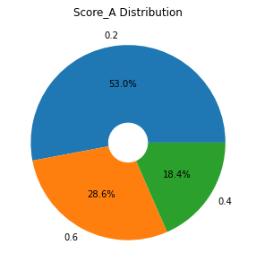
SCORE-A
More than half of the data in score A is for 0.2.Let us see the influence of Score A with Target variable
More data points with 0.2 as Score A. Let us analyse the distribution with pie plot

Slide 14
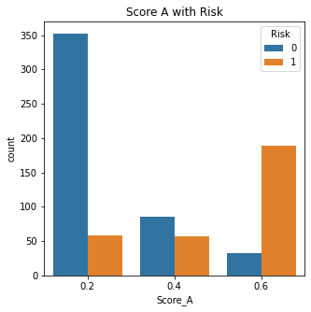
SCORE-A
With Score as 0.2 the there is less possibility of facing Risk. With 0.6 as score there is high possibility of facing risk. But with 0.4 as score there is almost equal probability of facing the risk though not having risk portion is higher.

Slide 15
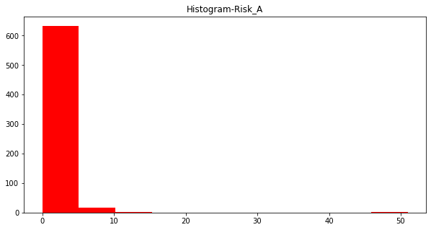
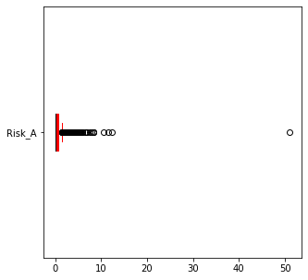
RISK-A

Slide 16
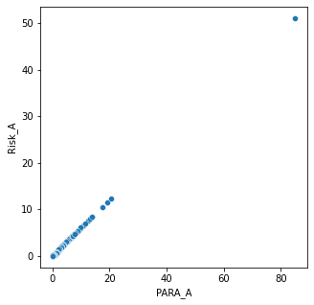
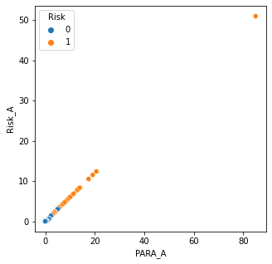
RISK-A

Slide 17
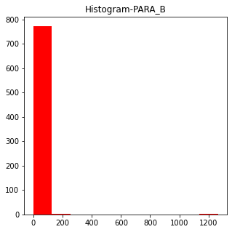
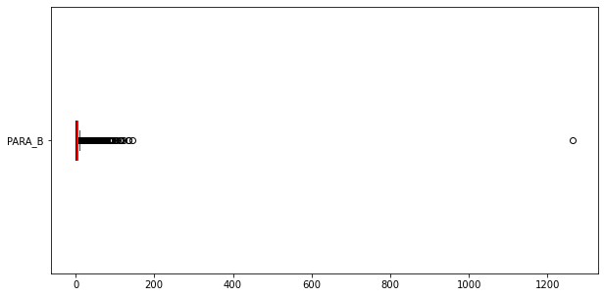
PARA-B
Since there are more than 17% of outliers lets remove till the threshold limit

Slide 18
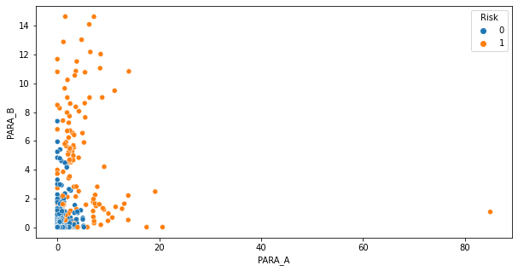
PARA-B

Slide 19
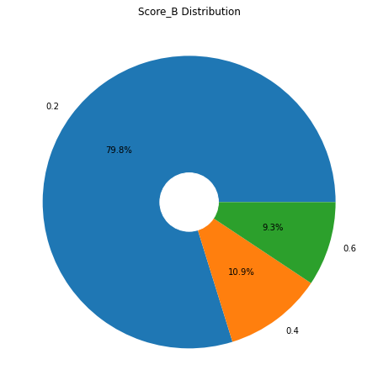
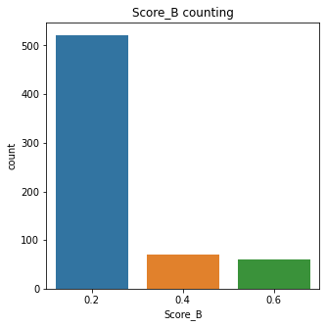
SCORE-B
80% of the data belongs of score B is for 0.2 .Let us see the influence of Score A with Target variable

Slide 20
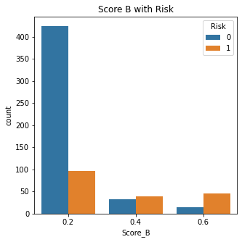
SCORE-B
With Score as 0.2 the there is less possibility of facing Risk. With 0.6 as score there is high possibility of facing risk. But with 0.4 as score there is almost equal probability of facing the risk though not having risk portion is higher.

Slide 21
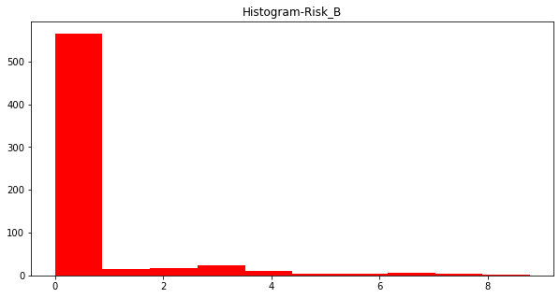
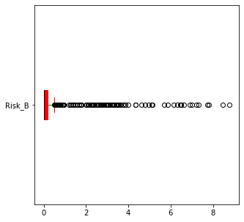
RISK-B
Since there are more than 18% of outliers lets remove till the threshold limit

Slide 22
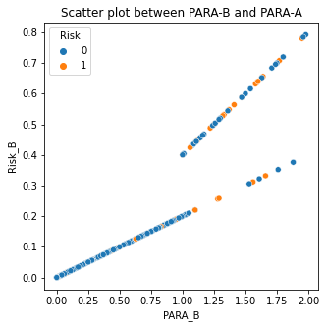
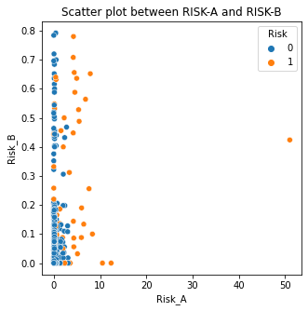
RISK-B

Slide 23
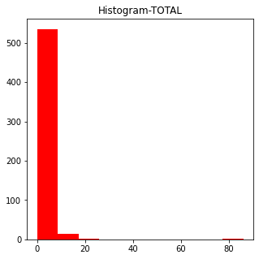
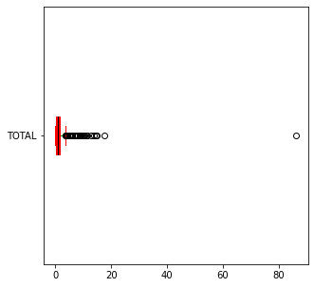
TOTAL
Since there are more than 7% of outliers, It doesn't effect much

Slide 24
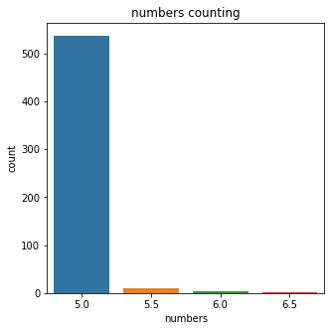
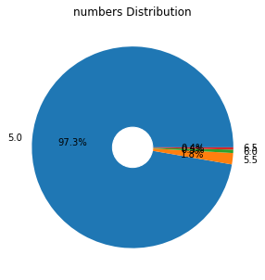
NUMBERS
97.3% of data belongs to 5

Slide 25
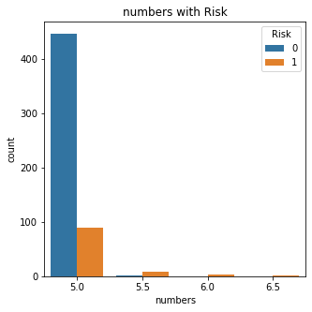
NUMBERS
with 5.0 risk is less with remaining numbers Risk probability is more

Slide 26
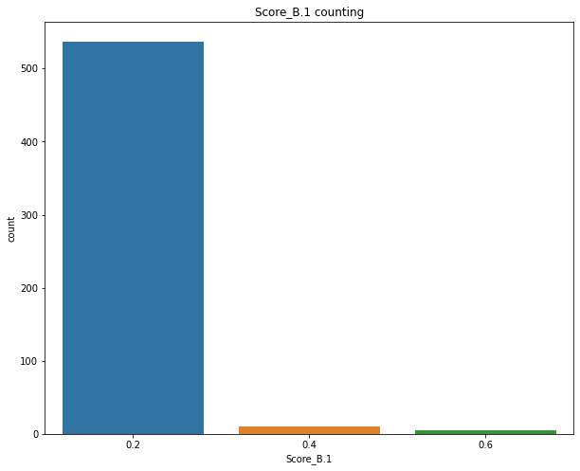

SCORE-B.1
97.3% of the data belongs of score B is for 0.2 .Let us see the influence of Score A with Target variable
Score with 0.3 are more in counts. Let us see the distribution with pi plot

Slide 27
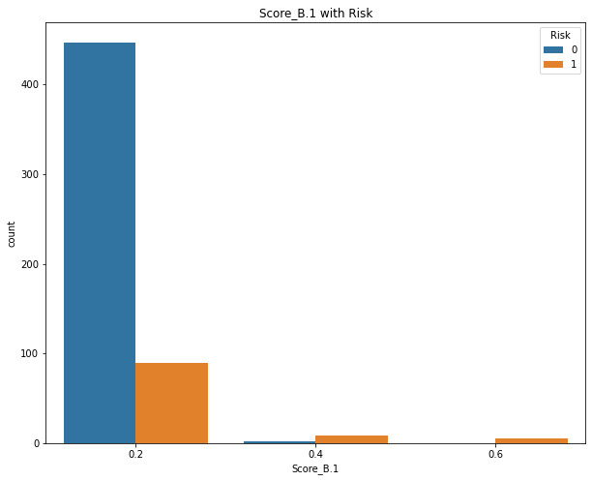
SCORE-B.1
With Score as 0.2 the there is less possibility of facing Risk. With 0.6 as score there is high possibility of facing risk.

Slide 28
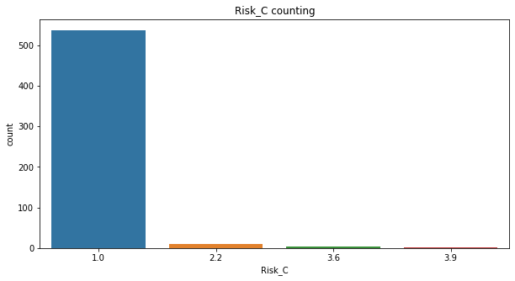

RISK-C
97.3% of the data belongs of Rick_C belongs to 1.0 .Let us see the influence of Risk C with Target variable
Risk C with 1.0 are more in counts remaining three are very less in count.Lets see the distribution using pie plot

Slide 29

RISK-C
Lesser the Risk_C score lesser the probability of facing overall Risk

Slide 30
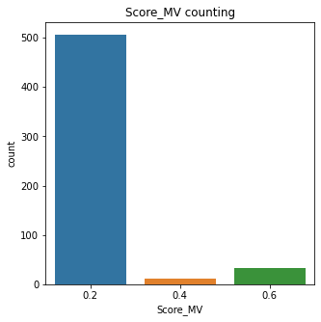
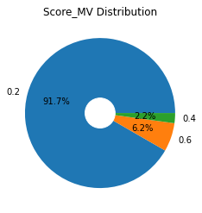
SCORE-MV
91.7% of the data belongs of Score_MV belongs to 0.2 .
Score_MV with 0.2 are more in counts remaining two are very less in count.Lets see the distribution using pie plot

Slide 31
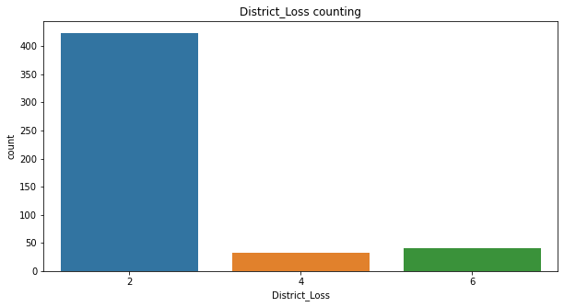
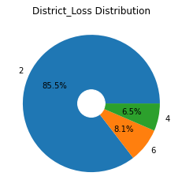
DISTIRCT LOSS
85.5% of the data belongs to 2 type of category lets check the influence with target variable
District loss with 2 type of category are more in number, 4 and 6 type of category are almost same in number. Lets analyse their distribution using pie plot

Slide 32
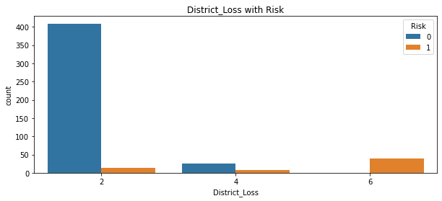
DISTIRCT LOSS
lesser the District Loss category less is the Risk probability

Slide 33
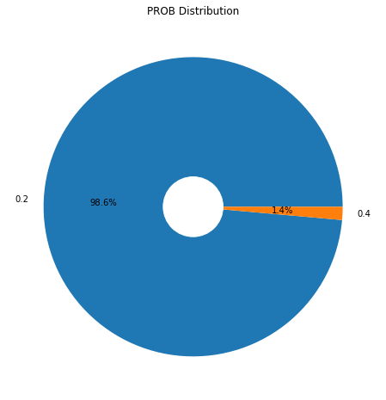
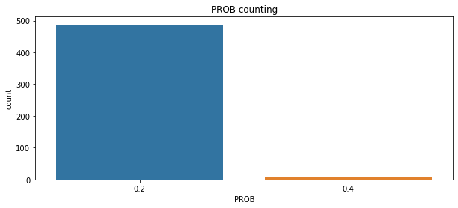
PROB
Probability with 0.2 are more in counts compared to 0.4.Lets analyse its distribution with pie plot

Slide 34
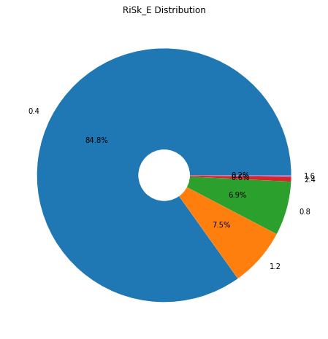
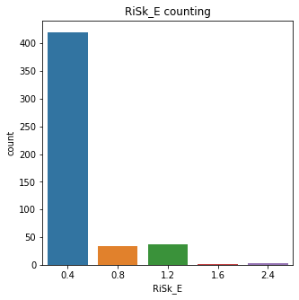
RISK-E

Slide 35
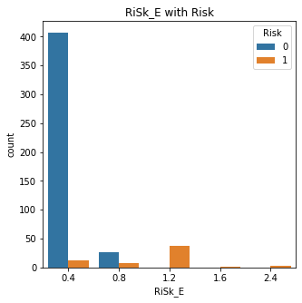
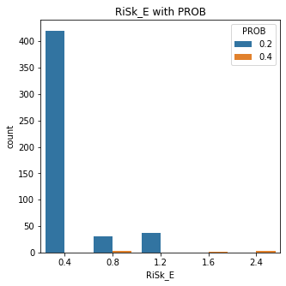
RISK-E
0.4 Risk_E factor has 0.2 probability and 0.4 probability is negligible. With 1.2 factor 0.2 probability is more than 0.8 factor's 0.2 probability

Slide 36
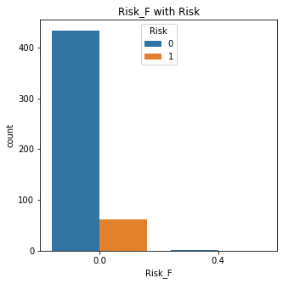

RISK-F

Slide 37



SCORE
Lesser the score lesser the chance of facing the risk

Slide 38



INHERITANT RISK

Slide 39


INHERITANT RISK

Slide 40


CONTROL RISK

Slide 41

DETECTION RISK

Slide 42


AUDIT RISK

Slide 43


AUDIT RISK

Slide 44

CORRELATION MATRIX
More than 10 coulmns are in good correlation with target variable

Slide 45

THANK YOU

